Slide 1
The Influence of Economic Indicator and Human Development on Carbon Dioxide Emission
Sheng Yun, Jingyan Xu
GSAS
Fordham University
CISC 5450

Slide 2
Introduction
Economic growth, technology, culture, and industrial policies affect environmental protection efforts.
When we focus too much on growth, we ignore environmental management.
Burning fossil fuel is the largest contributor to greenhouse gas emission, it emits CO2.
Environment and growth impact human development.
Question: How does the GDP affect CO2 emissions and what is the effect of HDI on CO2 emissions?

Slide 3
Dataset Sources and Detail
3 Datasets: National GDP, CO2 Emission, Human Development Index
They all have 4 attributes: Entity, Code, Year, annual GDP/CO2 emission/HDI
GDP: total income of all people/total expenditure on goods and services in an economy.
CO2 emission: CO2 emission accounts for 72% of total greenhouse gas emissions per year.
HDI: measurement of a country’s performance in human development concepts: health, education, and standard of living.

Slide 4
Relative Work Done by Others on the Same Dataset
Carbon Intensity
A key measure of economic-environmental balance.
Complex association between carbon intensity and political stability and economic structure.
Decoupling of energy consumption and growth
In countries like Germany, the UK, Sweden, Denmark, etc., CO2 emission level stays on the same level while GDP keeps increasing - suggest decoupling underway.
Education and GDP per capita
Richer countries tend to produce better education outcomes.
When income reaches certain level, the relationship between income and education outcomes becomes nonexistent.

Slide 5
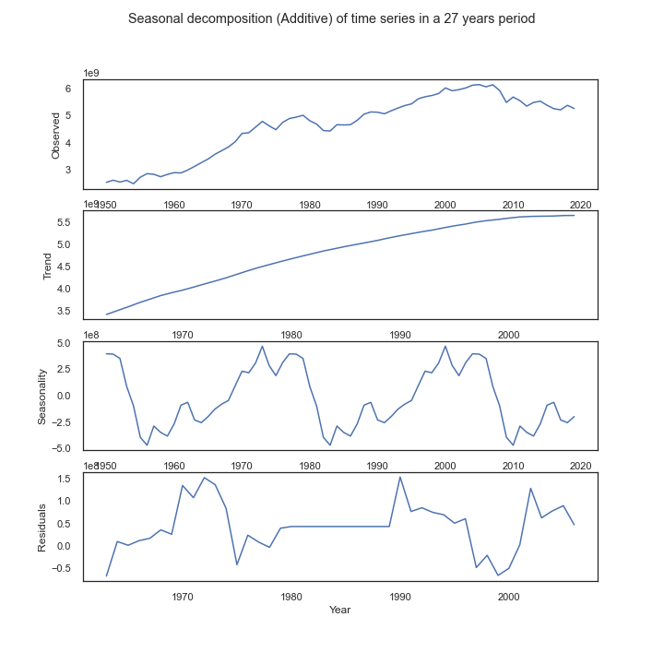

Time Series for CO2 Emission
Mono

Slide 6
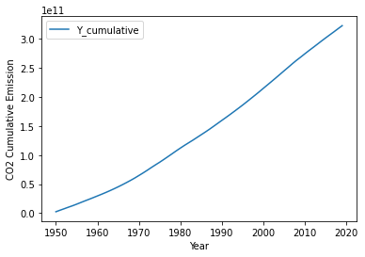
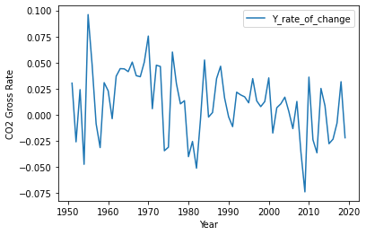



Cumulative and rate of change for CO2 Emission
Cumulative
Rate of Change

Slide 7
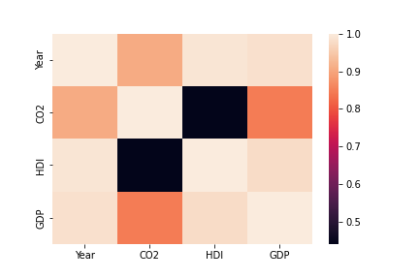
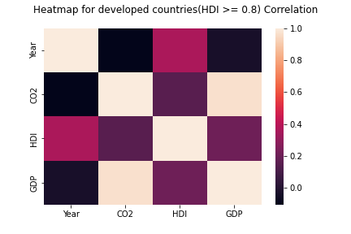


Correlation Heatmaps
USA
Developed Countries

Slide 8
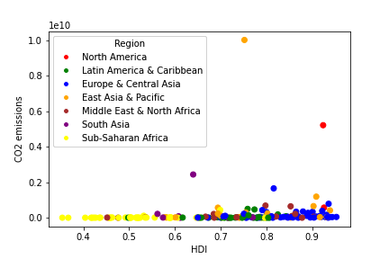
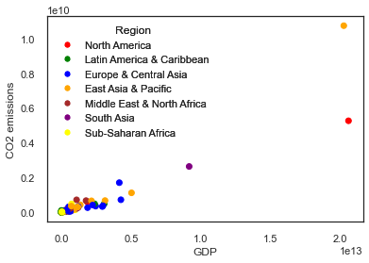
Scatterplot grouped by Regions
HDI VS CO2 (2017)
CO2 VS GDP (2019)

Slide 9
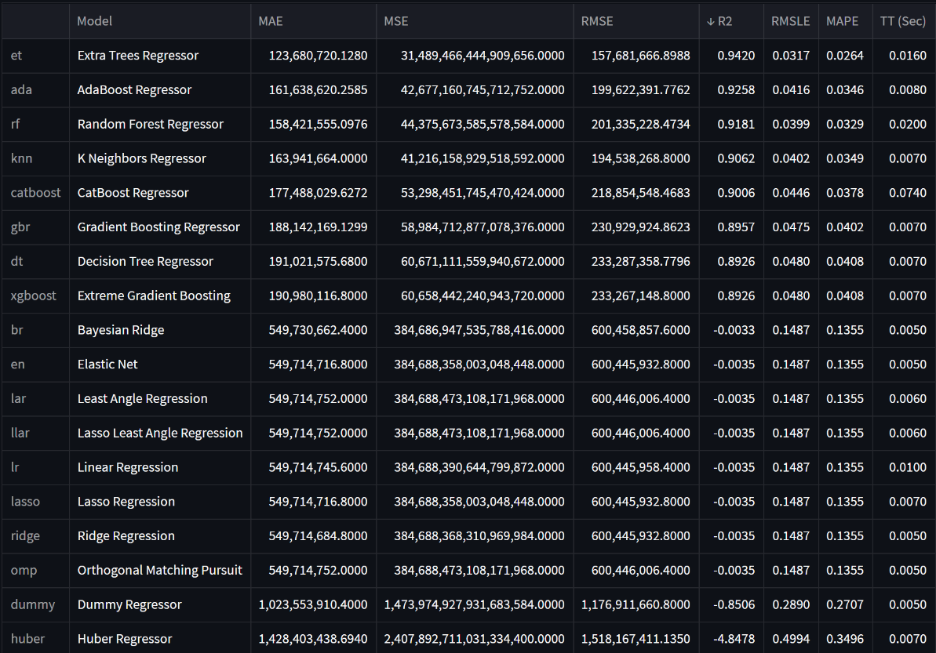
Regression Analysis GDP and CO2

Slide 10
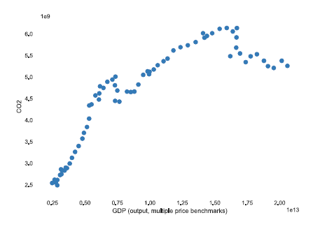
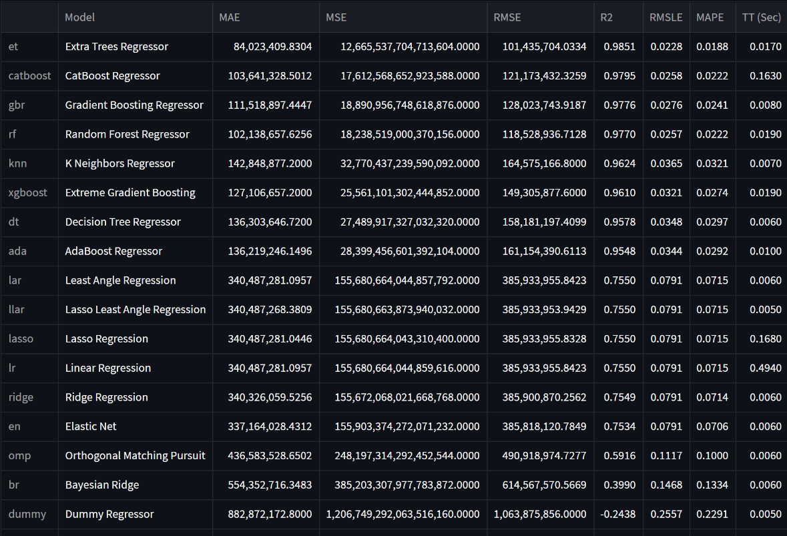
Regression Analysis GDP, Year and CO2

Slide 11
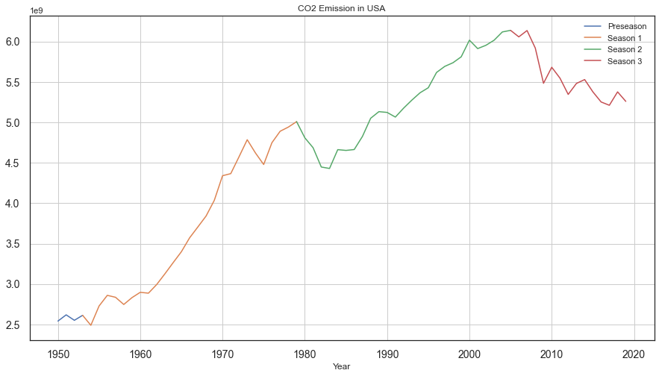
Back to Time Series

Slide 12
Conclusion
Strong and positive relationship between CO2 emissions and GDP, positive and ignorable relationship between CO2 emission and HDI.
Seasonality.
Replace current datasets with better ones; add more variables.
HIHD for human development, GDP per capita or Ginni coefficient for economic wellness.
Separate countries into different categories, such as income levels.

